Slide 1
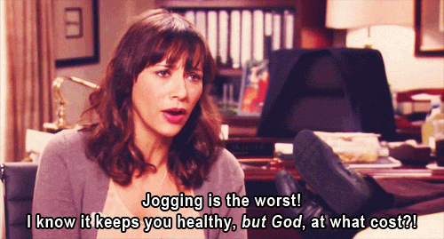
The Fitness Social
A social network for chill people who would like to keep their new year’s resolution for once
(and don’t like to jog)

Slide 2
What, why and who for
a social network for people who want to work out but are not already gym addict/do not have an iron will.
16-30 + , middle class (no money to spare on a private instructor)
Lack of proper support & sharing space for people working out and not taking themselves seriously
“The gym? No thanks, everyone’s crazy there” – Elisa, 21, not a gym addict, kinda would like to wOrk out from time to time
“I tried to do some ab work before going to bed, i held on for two weeks, then I missed one night and I was done” – Pauline, 22, total babe, does not need to work out but would like to anyway

Slide 3
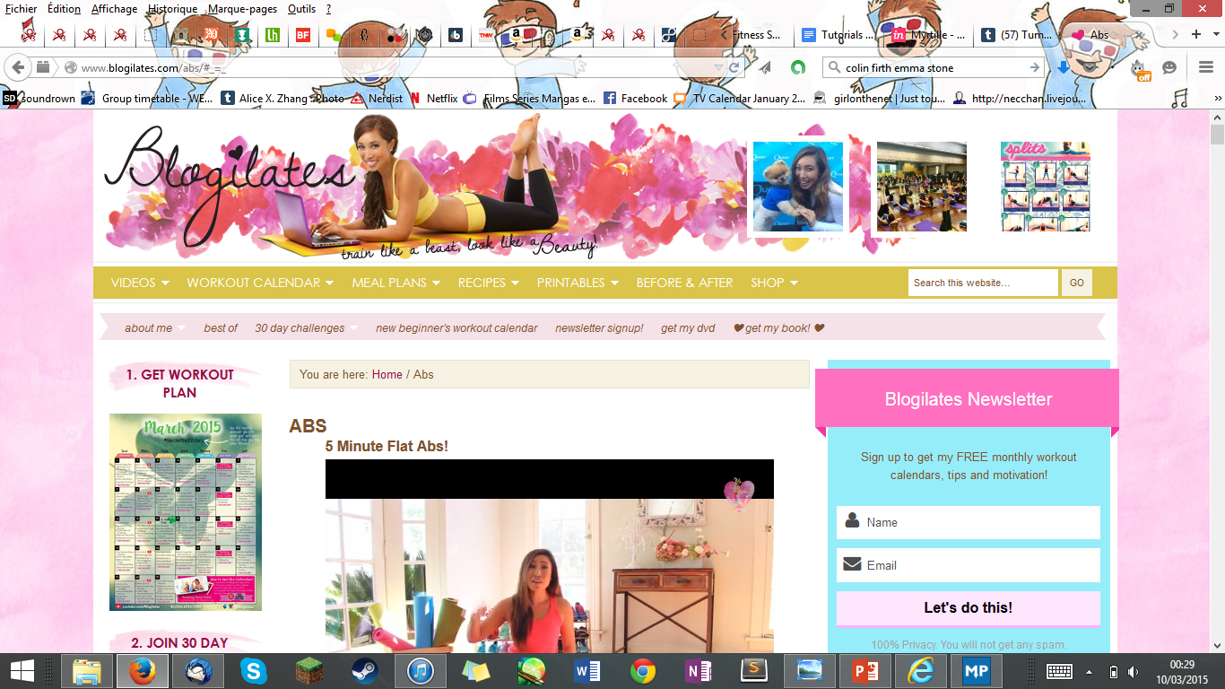
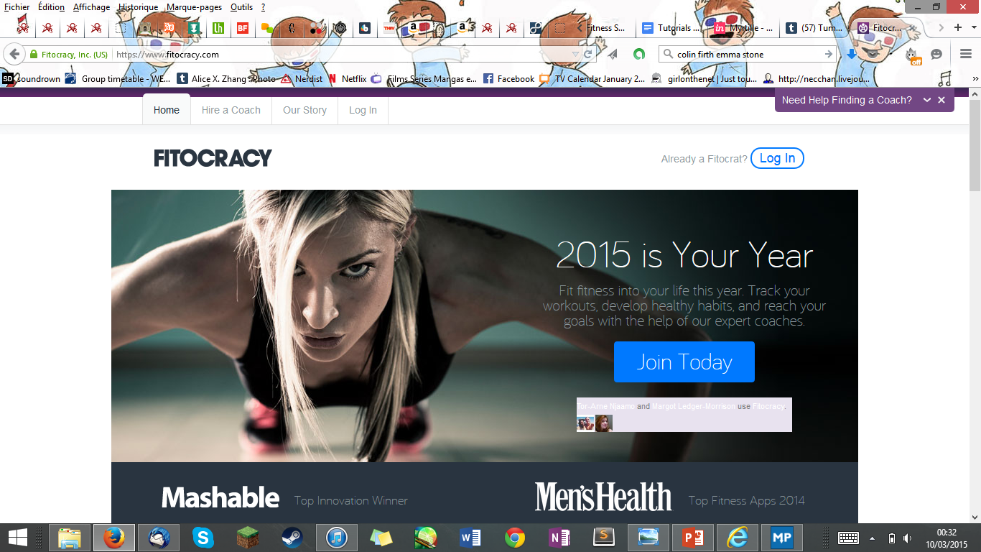
Competitor analysis: Blogilates & Fitocracy
Nice & aiming at same target, although very girly
Blog – follow only 1 person, no actual community
You can post & blog about it, but in the same way you would follow a famous diet
For gym fanatics
Very confusing if not already experienced in the topic
Freemium, pay to follow a plan made by other users
scary

Slide 4
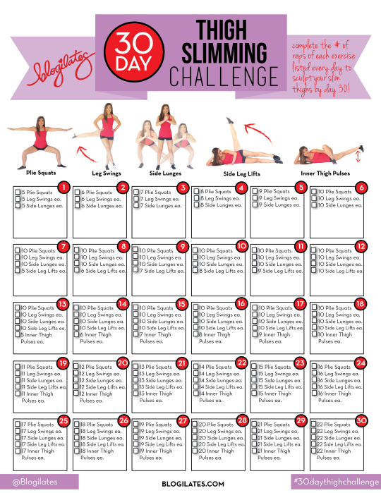
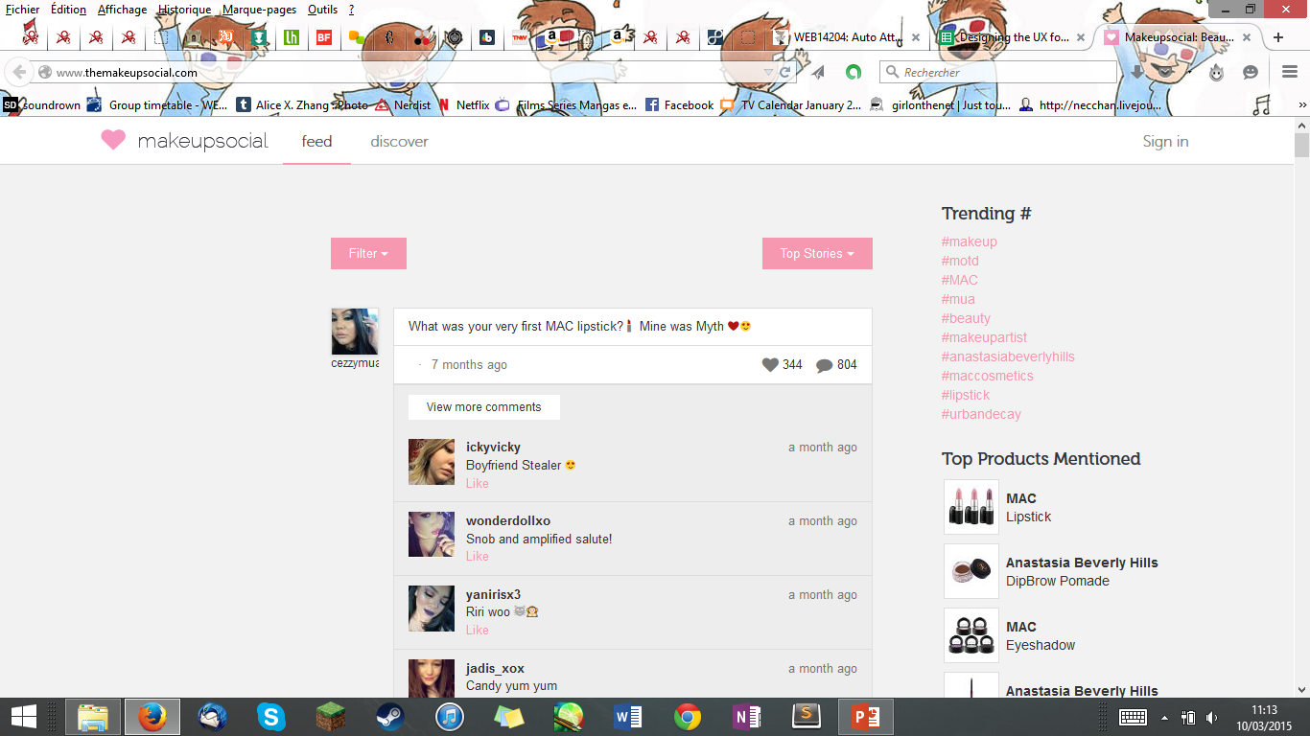
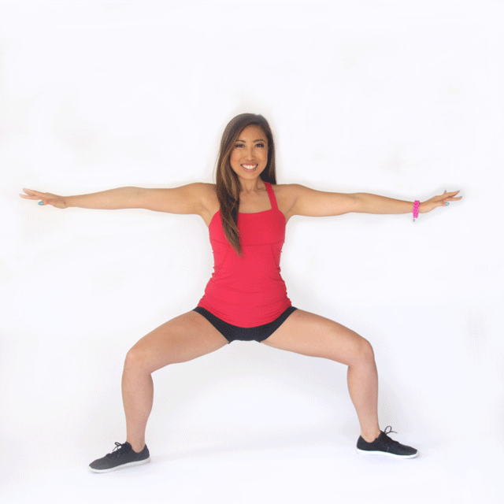
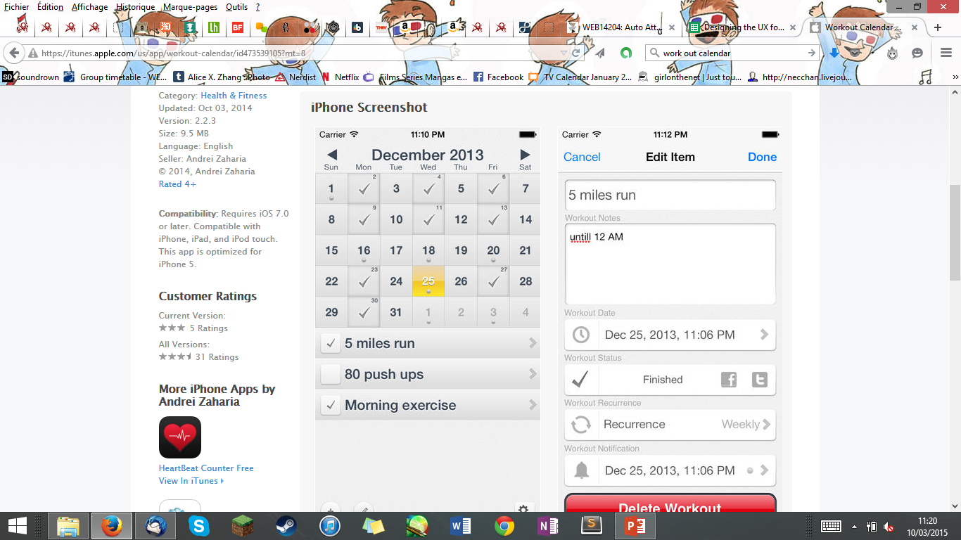
Inspirations

Slide 5

The fitness social is the perfect mix between scary gym warriors networks & fitness blog communities
Fun
Guidance throughout registering & after
No freemium
Not scary
You’re not alone anymore

Slide 6
Character study : meet meghan
20’s, average size, broke student
Would like to work out, but lacks both motivation & knowledge
Meghan has several options

Slide 7
Option 1
She tries to ask her friend chloe to be her
work out buddy
But they only know how to badly do squats

Slide 8
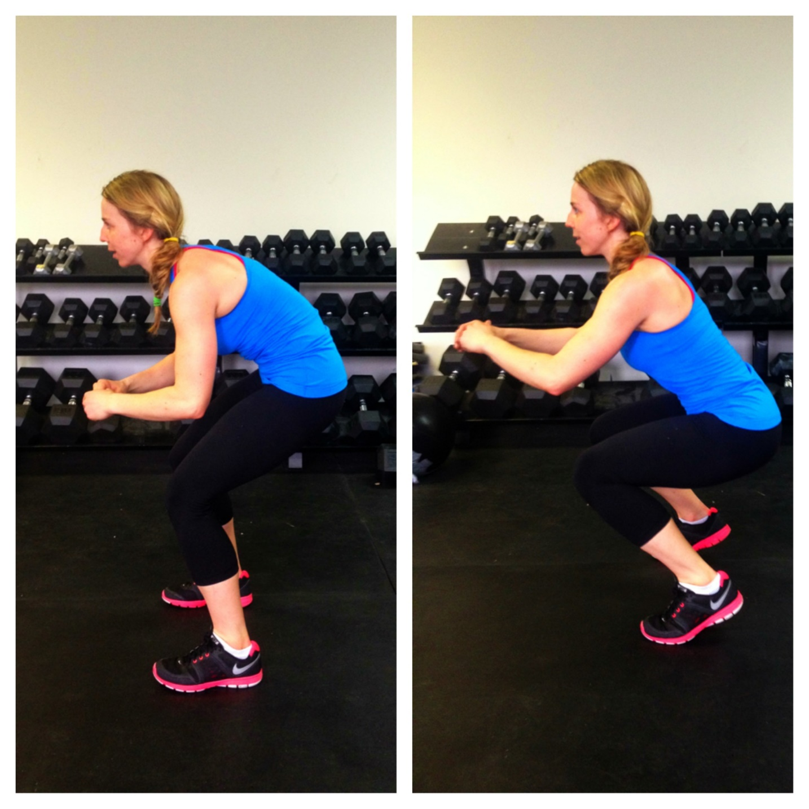

Slide 9

Chloe gives up after a week because she’s having an affair with Samantha
Meghan is alone again
Chloe’s a bitch

Slide 10
Option 2
Meghan tries to train by herself
She looks up videos on youtube
But there are too many!!!

Slide 11

Meghan is lost and getting fat

Slide 12
Option 3
Meghan goes to the deepest depth of the internet
And finally
FINALLY!

Slide 13




She finds it
The Fitness Social

Slide 14
Let’s see how Meghan can use the website
https://moqups.com/Myrtille/4RWbguFz/p:ab1eda5f6

Slide 15

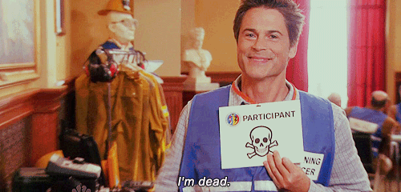
Meghan is all red, sweaty, and wants to die
It was a great work out!

Slide 16
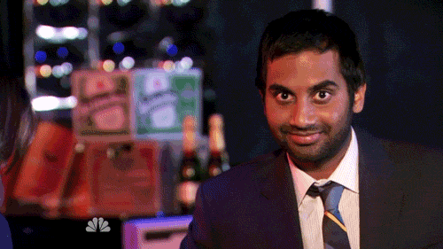
Thanks The Fitness Social, Meghan is happy!
She can eat as much cake as she wants
Without feeling guilty because of the societal norms forced upon her!!

